Slide 1

Cap-Ice Project Presentation
Adrian Gamutan – a125

Slide 2
MOTIVATION
Davao suffers in high temperatures during the day
Comfort and coolness while on the move
Learn more about the architecture of devices

Slide 3
TOP REQUIREMENTS
Comfort: Users want a device that is not a burden to use and wear around
Features: Sufficient and not too overbearing
Support: Ability to help users understand and troubleshoot the system and device
User-centeredness: Cater to specific needs of users and make them familiar with the product
Usability: Users want something easy to use that helps make their life easier

Slide 4
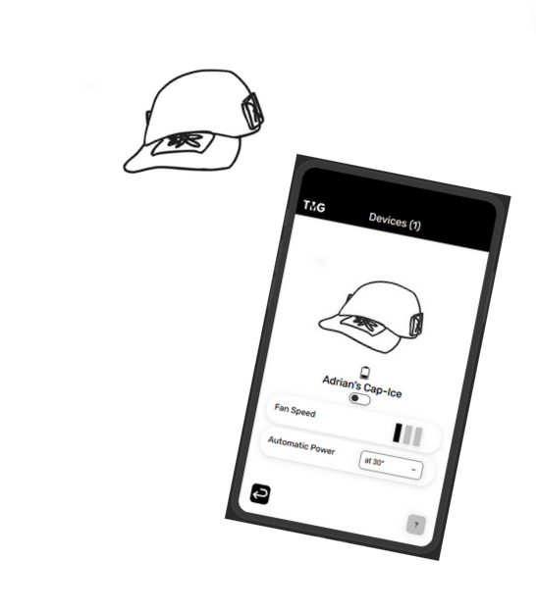
Solution Design: CAP-Ice

Slide 5
Solution Description
Cap-Ice is a cooling device that you can wear as a hat to keep cool under the sun without having to hold anything
Accompanied with an app for device control and monitoring
APPLICATION FEATURES:
- Battery monitoring
- Device power control
- Automatic power at set temperatures
- Fan speed control

Slide 6
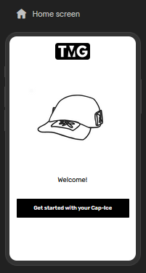
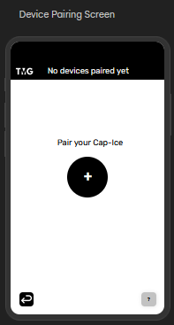
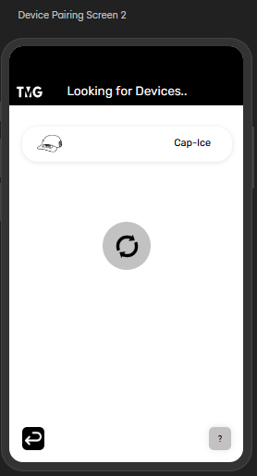
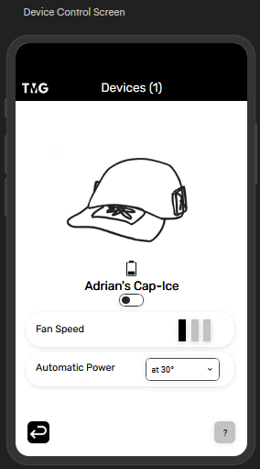
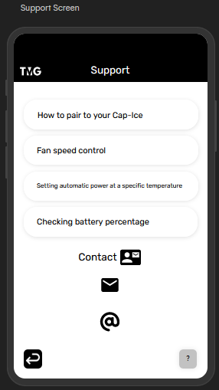
APPLICATION PROTOTYPE

Slide 7
EVALUATION Plan
Gather participants
Testing
Data Collection
Gather participants
Find people for testing of the prototype
Hand out the prototype link and questions to participants for evaluation
Collect and compare the gathered data from the participants to observe specific needs and opinions about the prototype
Evaluate on whether the prototype is well received or needs further improvement

Slide 8
PROTOTYPE TESTING
Process
A selected participant will try out the prototype application provided
3 Questions will be asked:
How does the application function?
What features should be added?
What features should be changed?

Slide 9
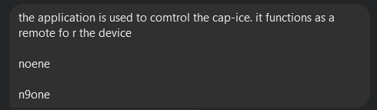

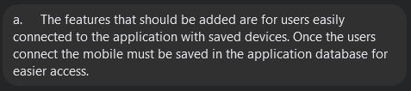
Testing Results
Participant 1
Participant 2

Slide 10
observations
Users did not have a need to get features changed
Option to be able to connect multiple devices was mentioned to be added
The application is working as intended

Slide 11
Conclusion
A bigger sample set would enable more diverse opinions and recommendations
The application is sufficient for the intention of the usage
The system makes users access the device efficiently

Slide 12

Thank you
GAMUTAN, Adrian C.
TMG – HCI A125

